Slide 1
LEGAL NEGOTIATIONS
Spring 2024
Negotiation Process
Brief Introduction to the Course & Syllabus + Negotiation Process & Ethics + Grading

Slide 2





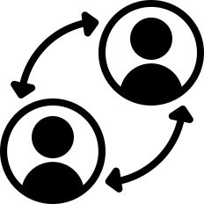



About the Course
Explain Negotiation Process | Identify Skills & Techniques | Understanding Styles
Develop your Strategy & Approach | Recognize Types of Negotiations | Engage in Active Negotiations
Become a Clearer Communicator | Become a Better Active Listener | Increase Genuine Curiosity

Slide 3
01
Syllabus
02
Reading
03
About the Course
Agenda
04
Exercises
05
Course Policies
06
Grading
07
Key Negotiation Terms
08
Negotiation Ethics
09
Online TKI Assessment

Slide 4

Syllabus
Let's check it out together (online)!
Notes:
Insert link.

Slide 5
Suggested Reading
"Bargaining for Advantage: Negotiation Strategies for Reasonable People" by G. Richard Shell, Wharton School Business Professor
"Getting to Yes" by Roger Fisher and William Ury
"Negotiation Genius" by Deepak Maholtra and Max H. Bazerman
"Difficult Conversations" by Douglas Stone, Bruce Patten, and Sheila Heen

Slide 6
About the Course:
Grading
Preparation, Professionalism, & Class Attendance
25%
Scored Negotiation #1
20%
Scored Negotiation #2
25%
Final Negotiation
30%

Slide 7


"Be curious, not judgmental" - Ted Lasso (incorrectly attributing the quote to Walt Whitman)

Slide 8




How do you get the most out of this course?
Prepare. Prepare. Prepare.
"Office Hours"
Keep a critique journal: In class feedback + Video Reviews

Slide 9
***Request***
If you know you are going to miss a class, please let us know as soon as possible (as this affects negotiation pairings).

Slide 10
Interest-based negotiations
Interest-based negotiations, also known as principled negotiations or integrative bargaining, is a collaborative approach to resolving conflicts and reaching agreements that focuses on the underlying interests and needs of the parties involved. Unlike traditional positional bargaining, where each party takes a rigid stance and seeks to maximize its own gain, interest-based negotiations aim to find mutually beneficial solutions by exploring common ground and addressing the interests and concerns of all parties.

Slide 11

Interest-based negotiations
In interest-based negotiations, the emphasis is on open communication, active listening, and creative problem-solving. Parties strive to understand each other's underlying motivations, priorities, and goals, seeking opportunities for collaboration and win-win outcomes. This approach fosters a cooperative and constructive environment, where trust and respect are cultivated, and where the parties work together to generate options and find innovative solutions that satisfy everyone's interests.
Interest-based negotiations provide a framework for resolving conflicts and reaching agreements that goes beyond mere compromise, allowing for the creation of solutions that maximize value and promote sustainable relationships. By focusing on interests rather than positions, this approach offers a path to effective problem-solving and enhanced long-term outcomes.

Slide 12
What is a "successful negotiation"?
A desirable outcome that fosters trust and follow through
A productive/efficient outcome that optimizes time and resources (without disregarding value)
The relationship can (hopefully) be strengthened, thus improving future interactions and communications
***Remember to negotiate in good faith & ethically***

Slide 13
Key Negotiation Terms
BATNA
Framing
Active Listening
Interest Generation
Best Alternative to a Negotiated Agreement
Think of "persuasion"
Not merely "hearing"
Underlying "why"
The course of action an individual or party will take if they fail to reach a satisfactory agreement through negotiation. Essentially, BATNA represents the fallback option or alternative that a negotiator has in case the current negotiation does not result in a desirable outcome. Having a strong BATNA is important as it provides leverage and enables negotiators to make informed decisions during the negotiation process.
Refers to the way information is presented or structured to influence the perception, interpretation, and outcome of a negotiation. It involves the strategic shaping of the negotiation context, issues, and options to sway the perspective and decision-making of the parties involved.
Active listening is a communication technique that involves fully engaging with and understanding the speaker's message. It goes beyond merely hearing the words being said and encompasses a deeper level of attentiveness and empathy. Active listening requires concentration, openness, and a genuine desire to comprehend the speaker's perspective.
Process of identifying and exploring the underlying needs, desires, concerns, and priorities of the parties involved. It involves delving beyond the stated positions and uncovering the fundamental interests that drive each party's desired outcomes.

Slide 14
Key Negotiation Terms
ZOPA
Aspiration Value
Reservation Value
Impasse
Zone of Possible Agreement
The best possible deal for your client
The worst possible deal you could take and still meet your client's interests
Yes, this can happen.
The ZOPA, also known as the "bargaining range" or "negotiation range," refers to the range of outcomes within which parties in a negotiation can potentially reach an agreement that is acceptable to all involved parties. In other words, it represents the space between the lowest offer a seller is willing to accept and the highest offer a buyer is willing to make.
W
These are the ideal or desired outcomes that each party hopes to achieve through the negotiation.
You are not required to reach a deal. Remember, negotiations in real life = a journey.
These are the lowest or highest points that each party is not willing to go beyond. It's the point where they would rather walk away from the negotiation than agree to a less favorable outcome.

Slide 15
BREAK
Take a moment. Shake it off. Dance like no one’s watching (but they will be, because there are a lot of people in this room and it’s a rather small room!).

Slide 16
Negotiation Ethics
The principles and standards that guide ethical behavior in the context of negotiations. It involves the moral considerations and values that individuals or parties should adhere to when engaging in the process of negotiation. Ethical negotiation practices aim to ensure fairness, honesty, transparency, and integrity in the negotiation process.

Slide 17
What is the TKI?
The Thomas-Kilmann Conflict Mode Instrument (TKI) is used by individuals and professionals to learn about how different conflict-resolution styles affect personal and group dynamics.

Slide 18
What does the TKI Measure?
The TKI measures preferences for five (5) different styles of handling conflict (aka: "Conflict Modes") which are described along two dimensions:
Assertiveness - The extent to which a person tries to satisfy their own concerns.
Cooperativeness - The extent to which they try to satisfy the concerns of another person.

Slide 19
Conflict Modes
Each mode represents a distinct approach to resolving conflicts, and individuals tend to have varying degrees of preference for each mode based on their personal traits, situational factors, and the nature of the conflict.
Competing
Collaborating
Compromising
Avoiding
Accommodating

Slide 20
Competing
This mode involves pursuing one's own interests and goals, often at the expense of the other party's concerns. Individuals using this mode are highly assertive and tend to take a firm stance on their own position, seeking to win the conflict. They might use power, authority, or persuasive tactics to achieve their objectives, sometimes without considering the needs or perspectives of others.

Slide 21
Collaborating
In this mode, individuals prioritize finding mutually beneficial solutions to conflicts. They invest time and effort in understanding all parties' interests and viewpoints, seeking a win-win resolution. Collaboration involves active communication, open sharing of information, and creative problem-solving. People using this mode are willing to make concessions and explore innovative solutions that address everyone's concerns.

Slide 22
Compromising
Compromising involves finding a middle ground that partially satisfies each party's needs and demands. People using this mode are willing to give up some of their goals to reach an agreement. It's a pragmatic approach that aims to achieve a reasonable level of satisfaction for all parties involved. However, this mode might not fully address all underlying issues and can lead to suboptimal outcomes.

Slide 23
Avoiding
In the avoiding mode, individuals try to evade or postpone conflicts rather than confronting them directly. This could be due to a desire to maintain harmony, reduce tension, or avoid unpleasant confrontations. Avoidance can be appropriate in situations where the issue is minor or when emotions are running high, but relying too heavily on this mode can lead to unresolved issues and potential escalation over time.

Slide 24
Accommodating
Accommodating involves prioritizing the other party's needs and preferences over one's own. People using this mode are willing to make concessions to maintain relationships and prevent conflicts from escalating. It can be a helpful mode when the issue at hand is of lesser importance to the individual, or when preserving harmony is crucial. However, overuse of this mode might lead to personal needs being consistently overlooked.

Slide 25
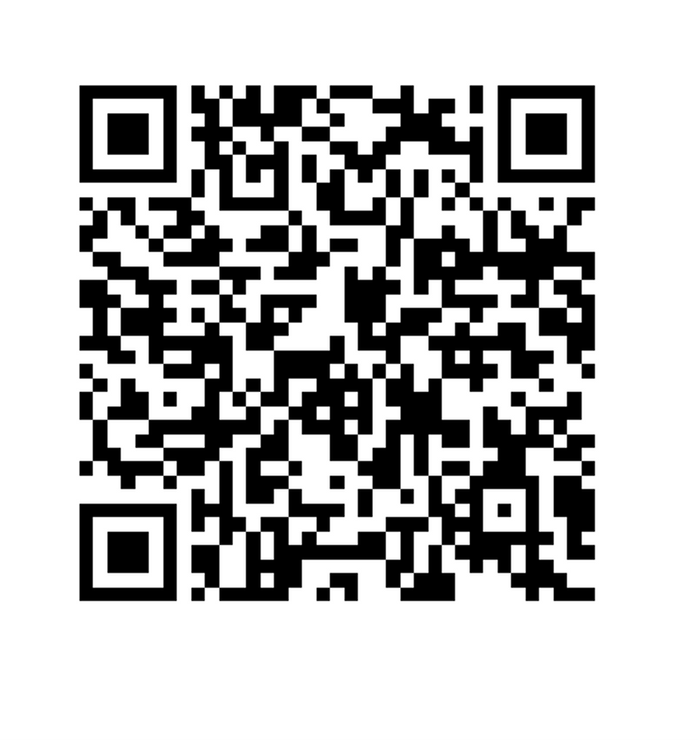
Online Assessment

Slide 26
Results
Are you surprised by your results?
Did you get your expected results?
How do you think this information can benefit you in negotiations?

Slide 27
Why does it matter?
Information Gathering
Don't make assumptions
We assume that others have the same negotiation and conflict styles as us.
Tips:
Negotiate smaller issues early on to gather information about your counterparts' negotiation and conflict resolution styles.

Slide 28
How to Improve our Results
1
2
3
4
Preparation. Preparation. Preparation.
Interest-Based
"ABC"
Relationship
Focus on interests, not positions. How can we maximize value for both sides?
Be patient and curious.
Consider not only the short-term, but long-term effects on the relationship. What type of relationship is this? Building? Repairing? Dissolving?
Consider the follow-through.
Adopt a willingness to prepare thoroughly for negotiation.

Slide 29
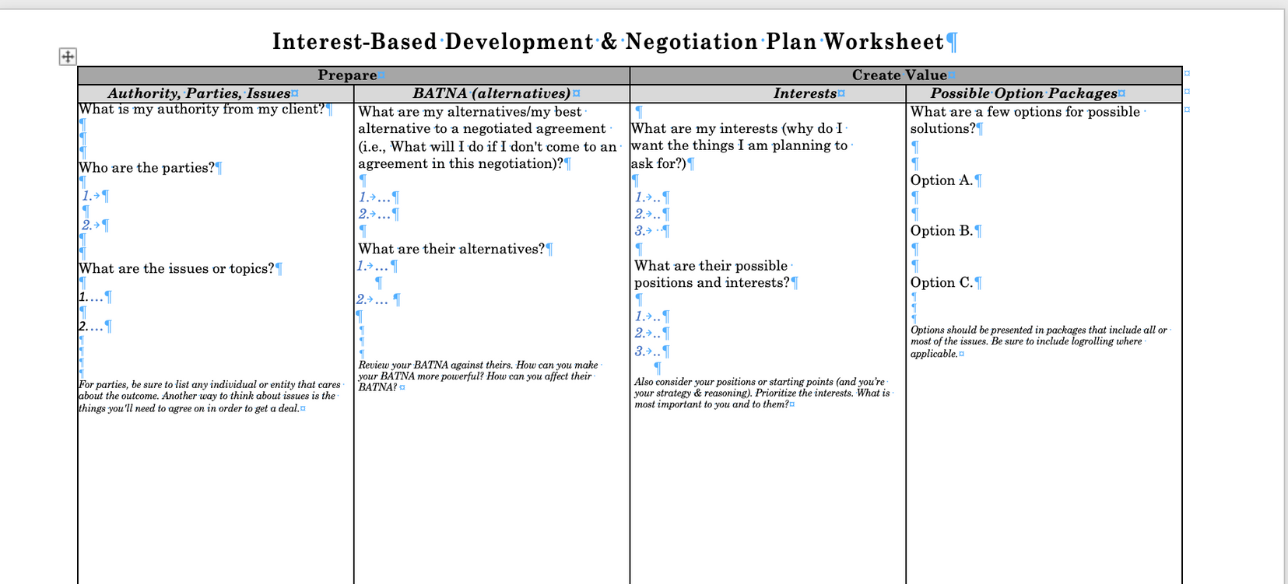
Sample Representation Plan

Slide 30
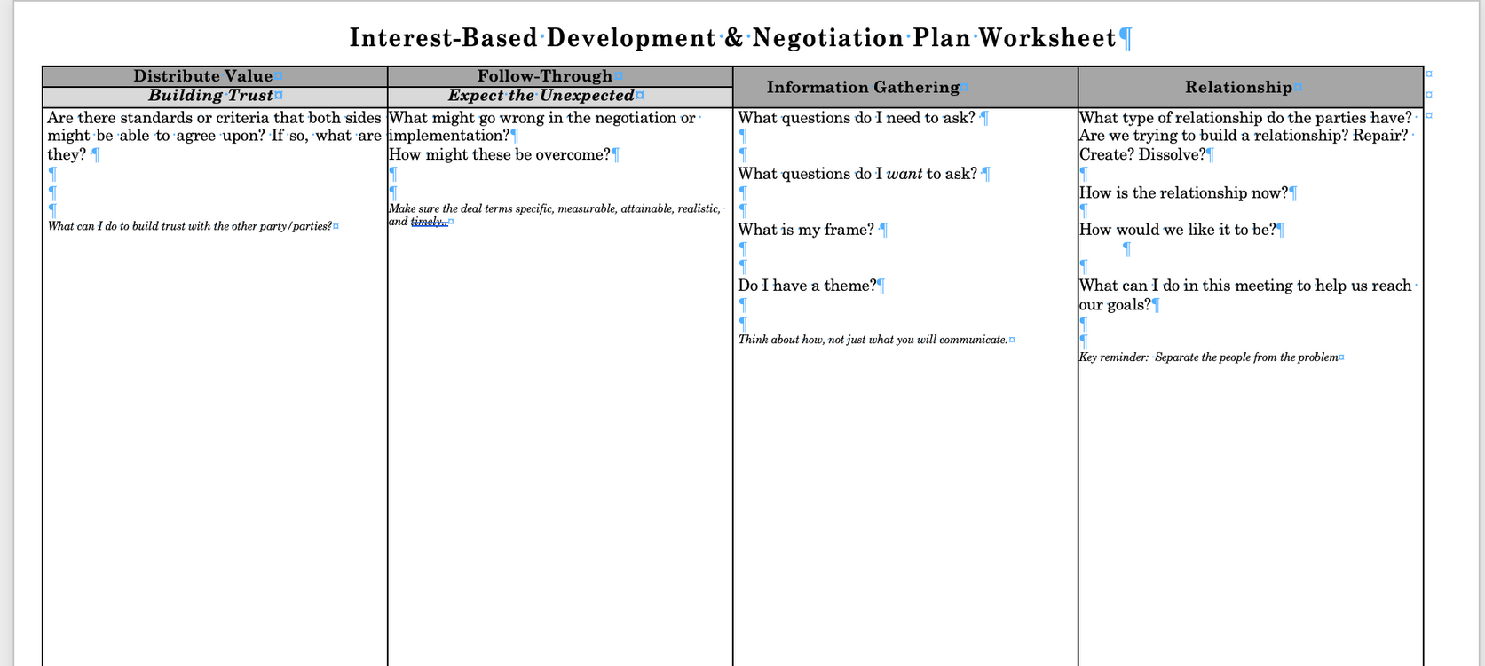
Sample Representation Plan

Slide 31
For next time...
LEGAL NEGOTIATIONS
SPRING 2024

